Slide 1
Network Infrastructure Design and Implementation
Work of:
Budai József
Csépányi Bárdos Letícia
Berki Dorina

Slide 2
Introduction
Our task was to design, test and implement a network infrastucture for a medium-sized company's three locations. The goal was to build a stable, secure, and scalable network that ensures the smooth operation of business processes and allows employees to work efficiently, whether on-site or through remote access.

Slide 3
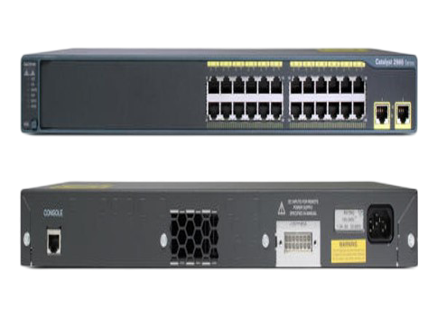
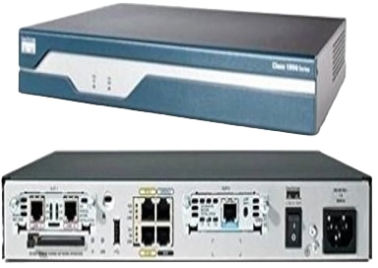
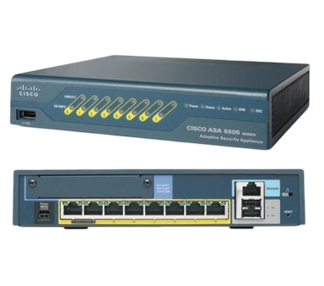
Devices Used
1841 Router
2960-24TT Switch
Cisco ASA 5505
Cisco ASA 5505

Slide 4
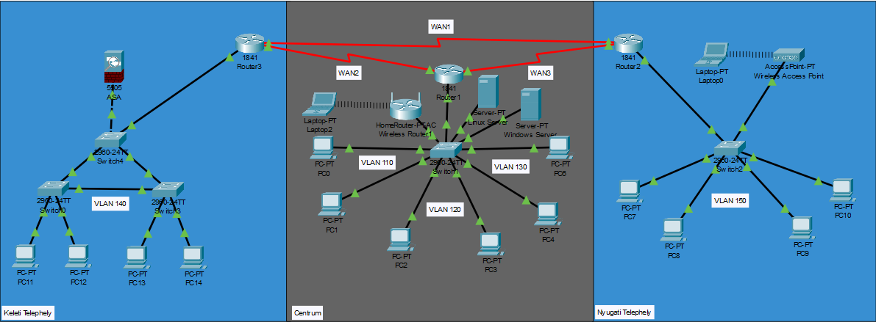
Physical Topology

Slide 5
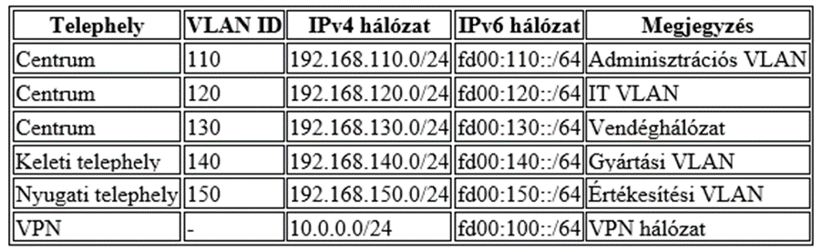
Logical Topology

Slide 6
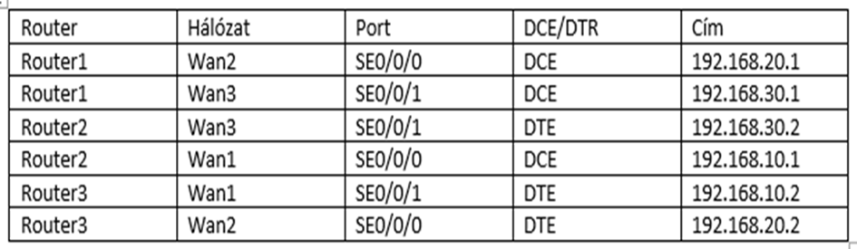
Logical Topology
WAN Address Table

Slide 7
Configuring devices
Technologies we have used to configure the devices:
DHCP
VLAN
OSPF
WAN

Slide 8
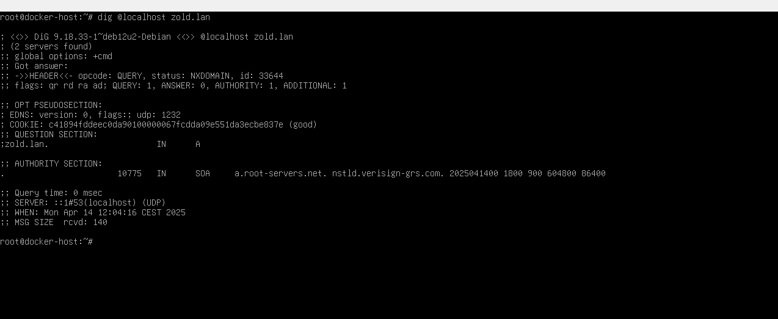
Testing

Slide 9
Group work division
Berki Dorina: Linux server
Csépányi-Bárdos Letícia: Documentation, Hungarian-language presentation
Budai József: Network topology creation and programming, English-language presentation.

Slide 10
THANK YOU FOR YOUR ATTENTION!

